Slide 1
The problem
acidoCEST MRI has shown to be solve a valuable tool to measure pH of several tissues accurately and with minor invasiveness.
The extraction of pH from a CEST spectra is usually done following a linear model developed by Pagel et al. However, this method has two limitations:
It does not consider variations in the CEST spectra that easily discernible by visual inspection or Lorentzian fitting
It assumes a linear relationship between the features extracted from a CEST spectra and the observed pH.
In this work, we propose to address these two limitations by:
Using all available information in the CEST spectra as a possible predictor of pH (with and without dimensionality reduction)
Creating flexible models that do not require a linear assumption between predictors and pH

Slide 2
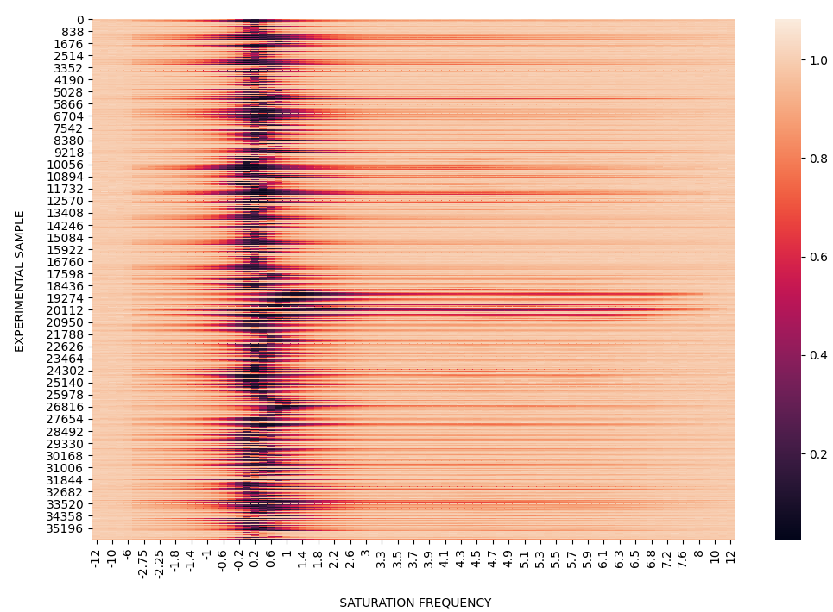
Our strategy
split
2
Testing data
1
2
Training data
4
3
Train model
4
Test model
Classification
Or
Regression
36,000 CEST spectra with 81 frequencies each
6 saturation times
6 saturation powers
T1, T2, B1, and B0 for all samples

Slide 3
Our strategy
Picture and or description of your MEGABOXES

Slide 4
Results

Slide 5
Results
But it is not a good idea to collect 85 saturation frequencies

Slide 6
Results
Use only stat frequencies with a variance >= 0.01
Freqs = -1.4, -1.2, -1, -0.8, -0.6, -0.4, -0.2, 0, 0.2, 0.4, 0.6, 0.8, 1, 1.2, 1.4, 1.6, 1.8, 2, 2.2, 2.4, 2.6, 2.8, 4.4,4.8,5.2,5.6

Slide 7
EXTRA
Machine Learning Pipeline and Code

Slide 8
ML pipeline

